Slide 1
Linking Strategy, Program Management and Architecture at the Enterprise Level
Enterprise Architecture “EA”
Dr. Hany Soliman Elnashar
PhD., PMP., ITIL., and TOGAF.
Computer Engineering And Systems Builder
Email: nhany73s@gmail.com

Slide 2
IT | Enterprise Architecture | المعمارية التكنولوجية للشركات
Credits | 3 Hours
Prerequisites | IT351
Contents | Design, selection, implementation and management of enterprise IT solutions. Applications and infrastructure and their fit with the business. Frameworks and strategies for infrastructure management, system administration, data/information architecture, content management, distributed computing, middleware, legacy system integration, system consolidation, software selection, total cost of ownership calculation, IT investment analysis, and emerging technologies. Managing risk and security within audit and compliance standards.

Slide 3
Text Books and reference's
Enterprise Architecture at Work Modelling, Communication, and Analysis
- Open Group Standard “ TOGAF® Version 9.1”, Copyr ight © 2011.

Slide 7
Introduction to Enterprise Architecture
Chapter 1

Slide 8
Introduction to Enterprise Architecture
Architecture
Enterprise Architecture
The Architecture Process
Drivers for Enterprise Architecture
Internal Drivers
External Drivers
Summary

Slide 9
1. Architecture
Architecture is the fundamental Organization of a system embodied in its components, their relationships to each other, and to the environment, and the principle guiding its design and evolution.

Slide 10
1. Architecture
Stakeholder: an individual, team, or Organization (or classes thereof) with interests in, or concerns relative to, a system.

Slide 11
2. Enterprise Architecture
Architecture at the level of an entire Organization is commonly referred to as ‘enterprise architecture’
Enterprise: any collection of Organizations that has a common set of goals and/or a single bottom line.

Slide 12
2. Enterprise Architecture
Enterprise architecture: a coherent whole of principles, methods,and models that are used in the design and realisation of an enterprise’s organisational structure, business processes, information systems, and infrastructure.

Slide 13
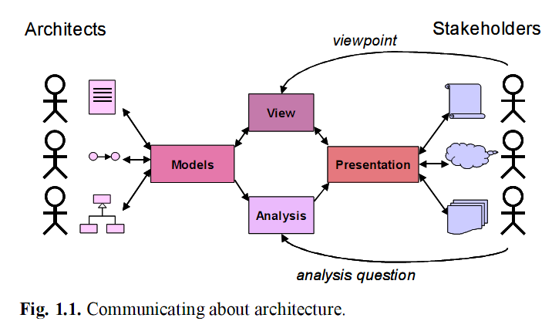
2. Enterprise Architecture
Even though an architecture captures the relatively stable parts of busi-
ness and technology, any architecture will need to accommodate change,
and architecture products will therefore only have a temporary status

Slide 14
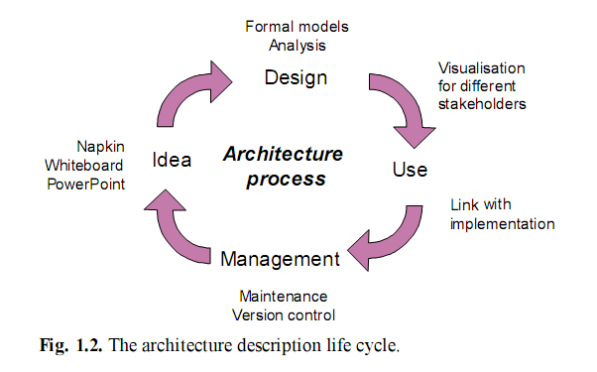
3. The Architecture Process

Slide 15
3. The Architecture Process
In all of the phases of the architecture process, clear communication with and between stakeholders is indispensable

Slide 16
4. Drivers for Enterprise Architecture
Internal Drivers
External Drivers
There are things, events, or situations that occur that affect the way a business operates, either in a positive or negative way. These things, situations, or events that occur that affect a business in either a positive or negative way are called "driving forces or environmental factors."

Slide 17
4.1. Internal Drivers
Internal driving forces are those kinds of things, situations, or events that occur inside the business, and are generally under the control of the company. Examples might be as follows
Organization of machinery and equipment
Technological capacity,
Organizational culture,
Management systems,
Financial management
Employee morale.

Slide 18
4.2. External Drivers
External driving forces are those kinds of things, situation, or events that occur outside of the company and are by and large beyond the control of the company. Examples of external driving forces might be, the industry itself, the economy, demographics, competition
External driving forces can bury a business if not appropriately dealt with. The question is, how does a business know what changes are occurring so that they can deal with them in a positive way, etc.

Slide 19
Summary
Enterprise architecture, more specifically, is defined as a coherent whole of principles, methods, and models that are used in the design and realisation of an enterprise’s organisational structure, business processes, information systems, and infrastructure.
Architecture models, views, presentations, and analyses all help to bridge the ‘communication gap’ between architects and stakeholdersigning complex structures

Slide 20
State of the Art
This chapter gives an overview of currently used methods and techniques
in enterprise architecture

Slide 21
State of the Art
Enterprise Architecture and Other Governance Instruments
Methods and Frameworks
Architecture Languages
Service-Oriented Architecture

Slide 22
1. Enterprise Architecture and Other Governance Instruments
The relation of enterprise architecture with some wellknown management practices in each of these areas:
Strategic Management: Balanced Scorecard
Strategy Execution: EFQM
Quality Management: ISO 9001
IT Governance: COBIT
IT Service Delivery and Support: ITIL
IT Implementation: CMM and CMMI

Slide 23
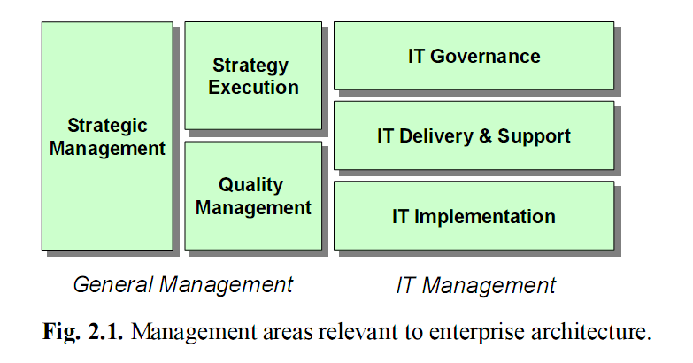
1. Enterprise Architecture and Other Governance Instruments

Slide 24
1.1. Strategic Management: Balanced Scorecard
The balanced scorecard (BSC) is a strategic performance management tool - a semi-standard structured report supported by proven design methods and automation tools that can be used by managers to keep track of the execution of activities by staff within their control and monitor the consequences arising from these actions.
Notes:
Chúng ta có thể mô tả BSC như là những nỗ lực hệ thống đầu tiên nhằm thiết kế một hệ
thống đo lường hiệu quả. Hệ thống này chuyển tầm nhìn và chiến lược của tổ chức thành
những mục tiêu cụ thể, phép đo và những chỉ tiêu rõ ràng. Những phép đo của BSC thể hiện
sự cân bằng giữa bốn khía cạnh: Tài chính, khách hàng, quá trình nội bộ và học hỏi, phát
triển. Các phép đo được lựa chọn sử dụng cho thẻ điểm là công cụ dành cho người lãnh đạo
sử dụng để truyền đạt tới người lao động và các bên liên quan những định hướng về kết quả
và hiệu quả hoạt động mà qua đó tổ chức sẽ đạt được những mục tiêu chiến lược của mình.
Có thể nói, về cơ bản công cụ này cùng một lúc là 03 hệ thống: Hệ thống đo lường, hệ
thống quản lý chiến lược và công cụ trao đổi thông tin

Slide 25
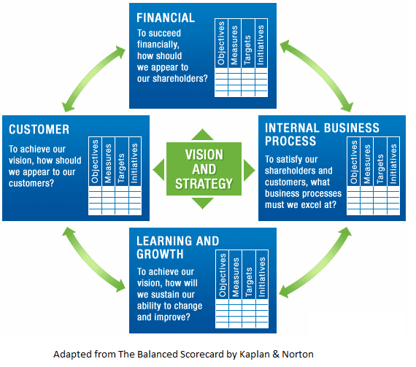
1.1. Strategic Management: Balanced Scorecard
Notes:
Chúng ta có thể mô tả BSC như là những nỗ lực hệ thống đầu tiên nhằm thiết kế một hệ
thống đo lường hiệu quả. Hệ thống này chuyển tầm nhìn và chiến lược của tổ chức thành
những mục tiêu cụ thể, phép đo và những chỉ tiêu rõ ràng. Những phép đo của BSC thể hiện
sự cân bằng giữa bốn khía cạnh: Tài chính, khách hàng, quá trình nội bộ và học hỏi, phát
triển. Các phép đo được lựa chọn sử dụng cho thẻ điểm là công cụ dành cho người lãnh đạo
sử dụng để truyền đạt tới người lao động và các bên liên quan những định hướng về kết quả
và hiệu quả hoạt động mà qua đó tổ chức sẽ đạt được những mục tiêu chiến lược của mình.
Có thể nói, về cơ bản công cụ này cùng một lúc là 03 hệ thống: Hệ thống đo lường, hệ
thống quản lý chiến lược và công cụ trao đổi thông tin

Slide 26
1.2. Strategy Execution: EFQM
EFQM (European Foundation for Quality Management)
It not only focuses on quality management, but provides an overall management framework for performance excellence of the entire organisation.
The EFQM Excellence Model is a practical tool that can be used in a number of different ways:
As a tool for self-assessment
As a way to benchmark with other organisations
As a guide to identify areas for improvement
As the basis for a common vocabulary and a way of thinking
As a structure for the organisation's management system
Notes:
EFQM Excellence Model là framework được sử dụng rộng rãi nhất ở châu Âu và là cơ sở cho phần lớn các giải thưởng về chất lượng tầm quốc gia và khu vực như giải Malcolm Baldridge Model ở Mỹ, Deming Prize ở Nhật.
Mô hình EFQM có một phạm vi rộng hơn nhiều so với ISO 9001
Nó không chỉ tập trung vào quản lý chất lượng, nhưng cung cấp một khuôn khổ quản lý tổng thể cho hiệu năng xuất sắc của toàn bộ tổ chức

Slide 27
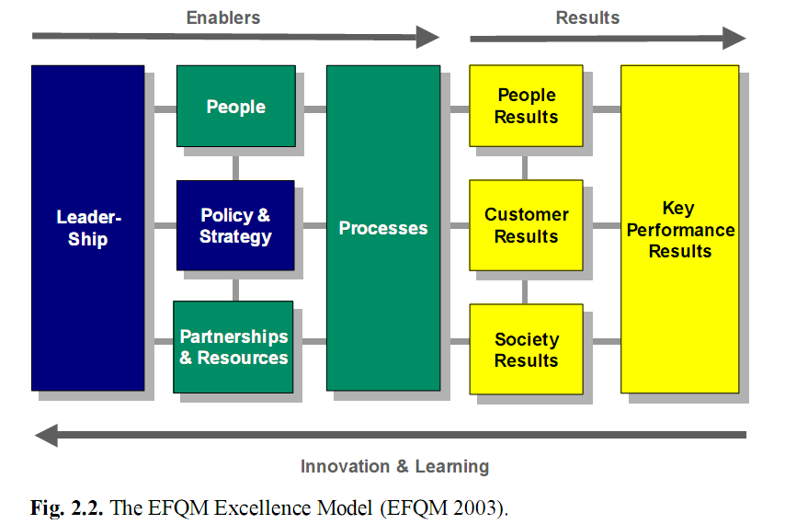
1.2. Strategy Execution: EFQM
Notes:
EFQM Excellence Model là framework được sử dụng rộng rãi nhất ở châu Âu và là cơ sở cho phần lớn các giải thưởng về chất lượng tầm quốc gia và khu vực như giải Malcolm Baldridge Model ở Mỹ, Deming Prize ở Nhật.
Mô hình EFQM có một phạm vi rộng hơn nhiều so với ISO 9001
Nó không chỉ tập trung vào quản lý chất lượng, nhưng cung cấp một khuôn khổ quản lý tổng thể cho hiệu năng xuất sắc của toàn bộ tổ chức

Slide 28
1.3. Quality Management: ISO 9001
The ISO 9001:2000 standard (ISO 2000) of the International Organisation for Standardisation (ISO) outlines criteria for a good quality management system (QMS).
Based on a quality policy and quality goals, a company designs and documents a QMS to control how processes are performed.
The requirements of the standard cover everything from how a company plans its business processes, to how these are carried out, measured, and improved.

Slide 29
1.4. IT Governance: COBIT
The COBIT (Control Objectives for Information and related Technology) standard for IT governance was initially published in 1996 by the Information Systems Audit and Control Association.
The core of the COBIT framework are the control objectives and management guidelines for 34 identified IT processes, which are grouped into four domains: planning and organisation, acquisition and implementation, delivery and support, and monitoring.

Slide 30
1.5. IT Service Delivery and Support: ITIL
ITIL (IT Infrastructure Library) is the most widely accepted set of best practices in the IT service delivery domain.
ITIL comprises a series of documents giving guidance on the provision of good IT services, and on the facilities needed to support IT.
ITIL is complementary to COBIT.
Management of the IT assets of an organisation is central to ITIL.

Slide 31
1.6. IT Implementation: CMM and CMMI
The Capability Maturity Model for Software (Paulk et al. 1993), also known as the CMM and SW-CMM, is a model for judging the maturity of an organisation’s software engineering processes, and provides organisations with key practices required to help them increase the maturity of these processes.
The CMM’s popularity has sparked off the development of similar maturity models in other fields, including enterprise architecture; see, e.g., the NASCIO Enterprise Architecture Maturity Model (NASCIO 2003).

Slide 32
1.6. IT Implementation: CMM and CMMI
In the CMMI maturity models in their most common form, there are five maturity levels, each a layer in the foundation for ongoing process improvement, designated by the numbers 1 to 5 (CMMI Product Team 2002):
Initial
Managed
Defined
Quantitatively Managed
Optimising

Slide 33
2. Methods and Frameworks
Enterprise Architecture Methods
Conceptual Foundation for Architecture: The IEEE Standard 1471-2000
The Zachman Framework
The Open Group Architecture Framework
OMG’s Model-Driven Architecture
Other Frameworks

Slide 34
2.1. Enterprise Architecture Methods
An architecture method is a structured collection of techniques and process steps for creating and maintaining an enterprise architecture.
The following methods for architecture development are worth mentioning:
Although meant for software development, the Rational Unified Process (RUP) (Jacobson et al. 1999).
The UN/CEFACT Modelling Methodology (UMM).
The TOGAF Architecture Development Method (ADM) developed by The Open Group.

Slide 35
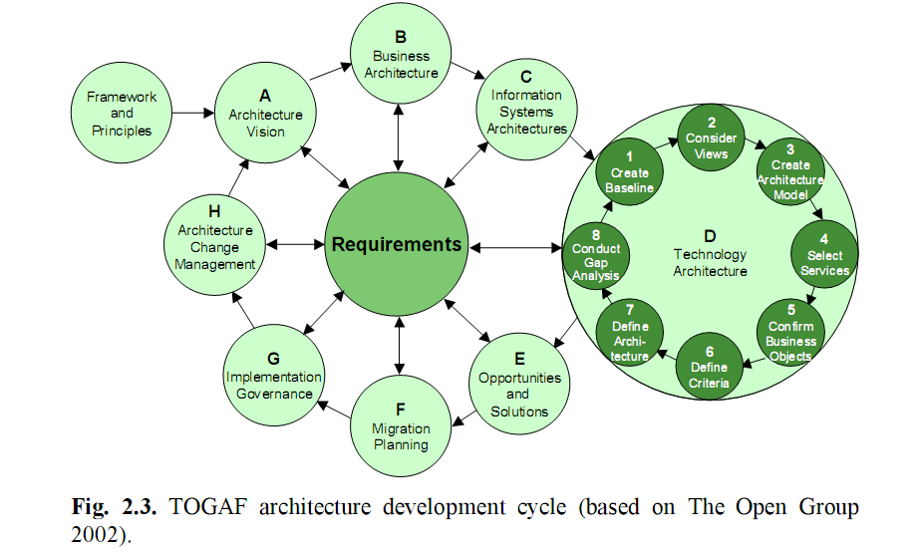
2.1. Enterprise Architecture Methods

Slide 36
2.2. Conceptual Foundation for Architecture: The IEEE Standard 1471-2000
IEEE 1471 focuses mainly on software-intensive systems, such as information systems, embedded systems, and composite systems in the context of computing.In this sense, it is similar to the framework of Zachman.
IEEE 1471 also does not try to standardise the process of developing architectures, and therefore does not recommend any modelling languages, methodologies, or standards.

Slide 37
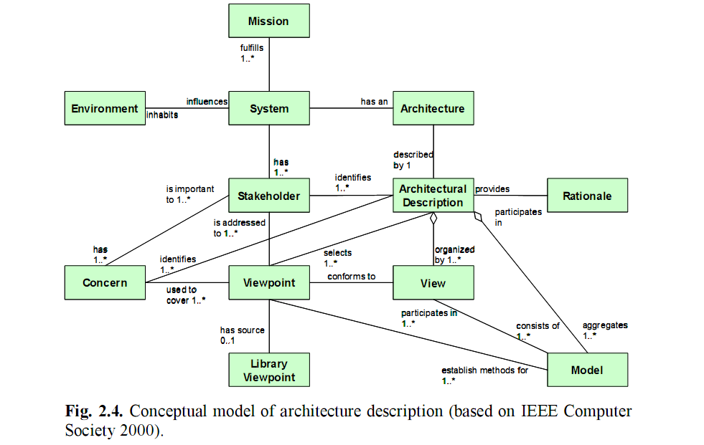
2.2. Conceptual Foundation for Architecture: The IEEE Standard 1471-2000

Slide 38
2.2. Conceptual Foundation for Architecture: The IEEE Standard 1471-2000
IEEE 1471 also provides a number of relevant architectural viewpoints together with their specifications in terms of concerns, languages, and modelling and analysis methods (see Annex D of the standard). It is important to note that architecture descriptions that are compliant with IEEE 1471 can be used to meet the requirements of other standards, like the Reference Model of Open Distributed Processing.

Slide 39
2.3. The Zachman Framework
In 1987, John Zachman introduced the first and best-known enterprise architecture framework (Zachman 1987), although back then it was called ‘Framework for Information Systems Architecture’.
The framework as it applies to enterprises is simply a logical structure for classifying and organising the descriptive representations of an enterprise that are significant to the management of the enterprise as well as to the development of the enterprise’s systems.

Slide 40
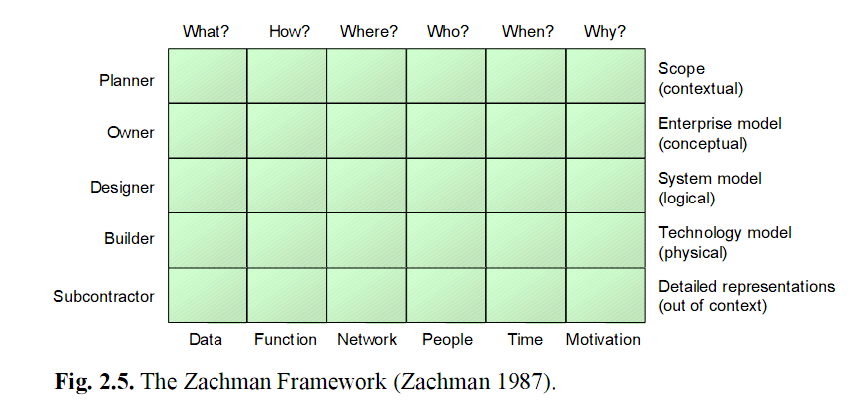
2.3. The Zachman Framework

Slide 41
2.4. The Open Group Architecture Framework
The Open Group Architecture Framework (TOGAF) originated as a generic framework and methodology for development of technical architectures, but evolved into an enterprise architecture framework and method.

Slide 42
2.4. The Open Group Architecture Framework
TOGAF has four main components:
A high-level framework, based on some of the key concepts and a methodology called the Architecture Development Method (ADM).
The TOGAF Enterprise Continuum
The TOGAF Resource Base, a set of tools and techniques available for use in applying TOGAF and the TOGAF ADM
TOGAF Reference Models

Slide 43
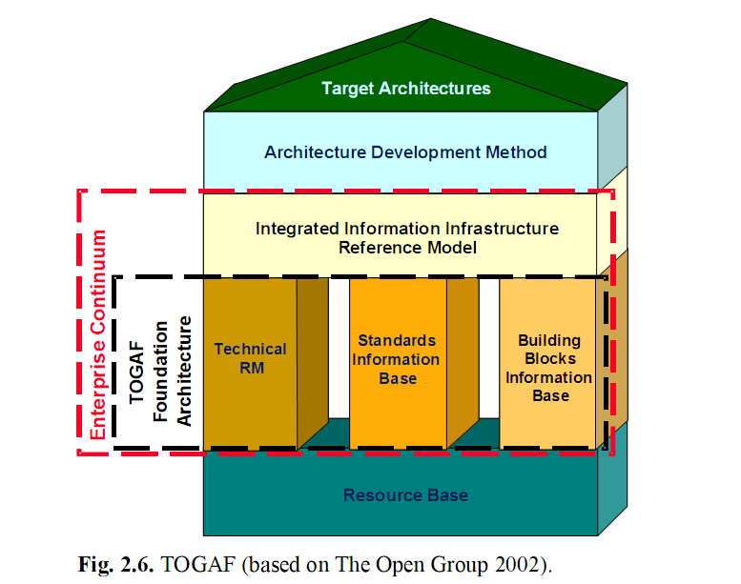
2.4. The Open Group Architecture Framework

Slide 44
2.5. OMG’s Model-Driven Architecture
The Model-Driven Architecture (MDA) (Object Management Group Architecture Board 2001, Frankel 2003) aims to provide an open, vendor neutral approach to interoperability.
It builds upon the Object Management Group’s modelling standards:
Unified Modeling Language (UML)
Meta Object Facility (MOF)
Common Warehouse Meta-model (CWM)
Platform-independent application descriptions built with these standards can be realised using different open or proprietary platforms, such as CORBA, Java, .NET, XMI/XML, and Web services.

Slide 45
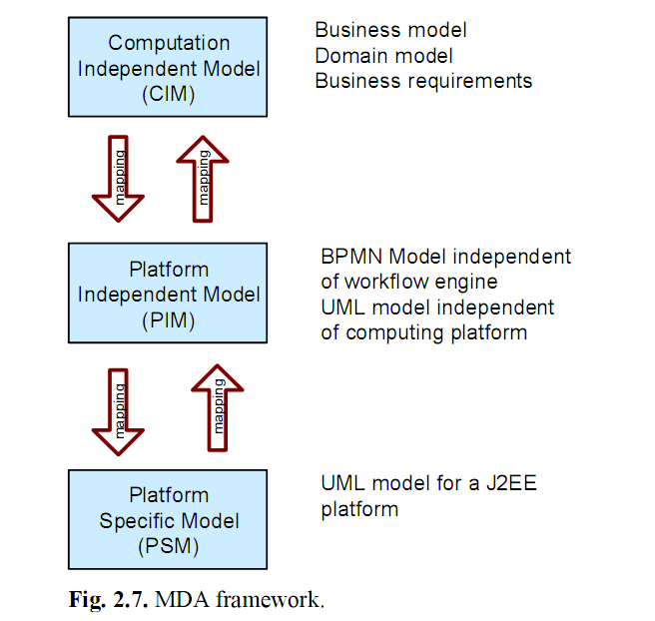
2.5. OMG’s Model-Driven Architecture

Slide 46
2.6. Other Frameworks
DoDAF/C4ISR: The Command, Control, Communications, Computers, Intelligence, Surveillance, and Reconnaissance (C4ISR).
RM-ODP: The Reference Model for Open Distributed Processing (RM-ODP) .
GERAM: The Generic Enterprise Reference Architecture and Methodology (GERAM).
Nolan Norton Framework (Zee, et al. 2000).

Slide 47
3. Architecture Languages
IDEF
BPMN
Testbed
ARIS
Unified Modeling Language
Architecture Description Languages
Suitability for Enterprise Architecture

Slide 48
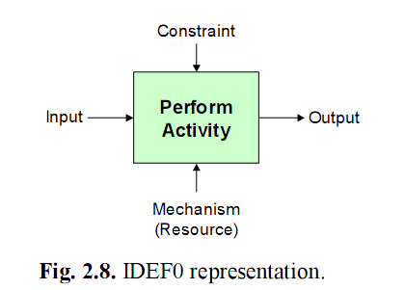
3.1. IDEF
The IDEF (Integrated Computer-Aided Manufacturing (ICAM) DEFinition) group of ethods have a military background.
There are 16 IDEF methods. IDEF0, IDEF3, and IDEF1X (‘the core’) are the most commonly used.
There are five elements to the IDEF0 functional model

Slide 49
3.2. BPMN
The Business Process Modelling Notation (BPMN) is one of the standards being developed by the Business Process Management Initiative (BPMI).
BPMI is a not-for-profit organisation, which states as its goals: (1) the specification of open standards for process design, and (2) the support of suppliers and users of business process management techniques and tools.

Slide 50
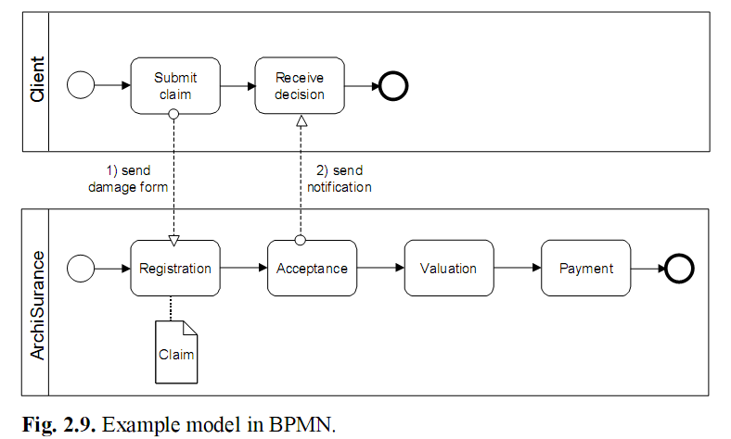
3.2. BPMN

Slide 51
3.2. BPMN
BPMN is restricted to process modelling; applications or infrastructure are not covered by the language.
The main purpose of BPMN is to provide a uniform notation for modelling business processes in terms of activities and their relationships (Fig. 2.9)

Slide 52
3.3. Testbed
Testbed is a business modelling language and method originally developed by the Telematica Instituut together with a consortium of companies.
It is intended for business process and organisation modelling and its target users are mostly business consultants; consequently, the language lacks the architectural perspective of information systems and the concepts related to this.

Slide 53
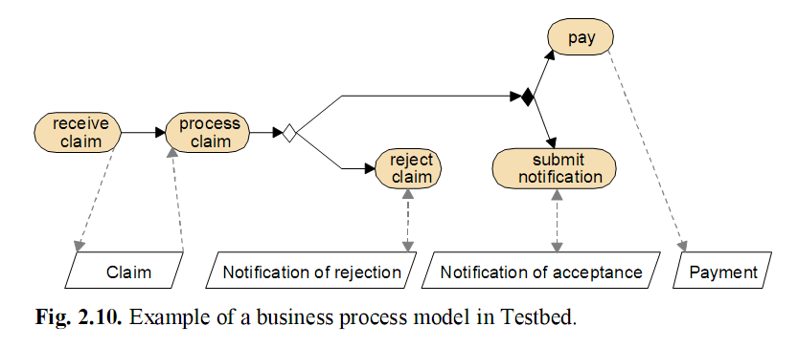
3.3. Testbed

Slide 54
3.4. ARIS
ARIS (‘Architecture of Integrated Information Systems’, Scheer 1994) is a well-known approach to enterprise modelling.
To model business processes within an enterprise model, ARIS provides a modelling language known as event-driven process chains (EPCs).

Slide 55
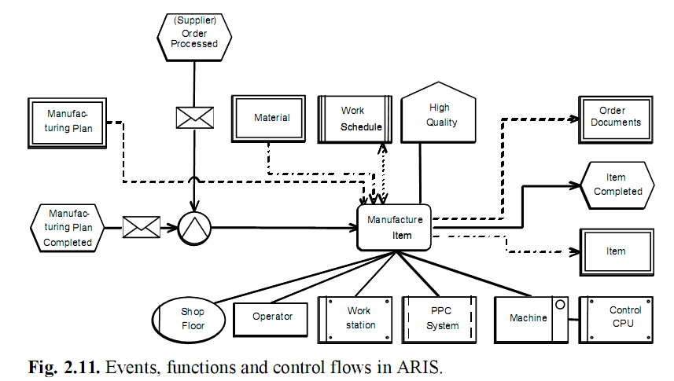
3.4. ARIS

Slide 56
3.5. Unified Modeling Language
The Unified Modeling Language (UML) (Booch et al. 1999) is currently the most important industry-standard language for specifying, visualising, constructing, and documenting the artefacts of software systems.
UML is intended to be used by system designers.
Through object orientation, UML covers all possible modelling domains one can think of.
UML partially has a formal basis.

Slide 57
3.6. Architecture Description Languages
The term ‘Architecture Description Language‘ (ADL) is used to refer to a (usually formal) language to describe a software architecture in rather general terms.
Acme (1998) is claimed to be suitable as a general architecture description and interchange language.
ADLs like Acme generally have an academic background, and limited usage.

Slide 58
3.7. Suitability for Enterprise Architecture
there are a number of aspects on which almost all of these languages score low:
The relations between domains (views) is poorly defined, and the models created in different views are not further integrated.
Most languages have a weak formal basis and lack a clearly defined semantics.
Most languages miss the overall architectural vision and are confined to either the business or the application and technology sub-domains.

Slide 59
4. Service-Oriented Architecture
Service-Oriented Technologies
Relevance and Benefits for Enterprise Architecture

Slide 60
4.1. Service-Oriented Technologies
Web services are a relatively young technology in full development, sustained by a rapidly evolving set of industry standards.
We are witnessing strong competition for the leading positions in the Web services market. The list of competing companies includes big supporters of Web services such as Microsoft with its .Net strategy, IBM with its WebSphere, its ‘business on demand’ framework and its patterns for ebusiness, Novell with its DENIM (Directory-Enabled Net Infrastructure Model) cross-platform infrastructure, Sun with its ONE (Open Net Environment), BEA Systems with its WebLogic, and many others.

Slide 61
4.2. Relevance and Benefits for Enterprise Architecture
Service concept is used and understood in the different domains making up an enterprise. In using the service concept the business and IT people have a mutually understandable ‘language’, which facilitates their communication.
Service orientation has a positive effect on a number of key differentiators in current and future competitive markets, i.e., interoperability,flexibility, cost effectiveness, and innovation power.
By focusing on services, many opportunities for reuse of functionality will arise, resulting in more efficient use of existing resources.
Service orientation stimulates new ways of thinking.

Slide 62
The end.

